Slide 1

DEFAULT OF CREDIT CARD CLIENTS
Big Data Machine Learning Course-TEAM 15
NIKITA JINDAL GUHA & NAINA GROVER
Reference: Default of Credit Card Clients
Notes:
Hello everyone, our Team 15, me Nikita Jindal & Naina Grover worked on the project to predict if the clients would default the credit card payments. Next slide

Slide 2
Thesis
We propose Random Forest & Adaboost classifier to solve the problem of predicting default credit card transactions in Taiwan. From the perspective of risk management, the result of predictive accuracy of the estimated probability of default will be more valuable than the binary result of classification - credible or not credible clients.
For our analysis, we assume overall cost of misclassification of a transaction is:
False negative = $167,000
False Positive = $10,000
Random Forest & Adaboost gives highest accuracy of 81%
 | Non-Default | Default
Non-Default | -$1000 | -$10,000
Default | -$167,000 | $0
Notes:
The thesis of our project is that we propose Random Forest & Adaboost classifier to solve the problem of predicting default credit card transactions in Taiwan. From the perspective of risk management, the result of predictive accuracy of default will be more valuable than the binary result of classification being credible or not credible clients.
For the analysis we have assumed cost for misclassification of a transaction. The False negative i.e. a transaction predicted as default being actually classified as non-default to be $167,000. We estimated this by taking an average of credit limit balance of 30,000 transactions of our dataset. The False Positive i.e. a non default being classified as default costs bank $10,000 i.e. minimum value of credit limit balance bank provides to a client. A non-default client being classified as default will be cost $1000 which we assumed the basic processing fee for a bank. Lastly a default transaction being correctly classified as default will incur no cost. Next slide

Slide 3

Approach
EDA Analysis
Data Modeling
Conclusion
Data cleaning
Data Understanding & Visualization
Split Data into 70% training & 30% test
Apply different models
Apply SMOTE technique
Evaluation (Model Performance)
Create Feature Importance
SWOT Analysis
Notes:
Our approach to creating the model is to first conduct an exploratory data analysis of our dataset. This helped us to identify any need for data cleaning, understand the key features of dataset and identify if there is any data imbalance. We then created multiple data models by first splitting the data into 70% training set & 30% into test set. Since our data had imbalance we also used SMOTE technique to reduce imbalance and again run the models to check the accuracy. Lastly we evaluated the model performance, prepared the feature importance and did the SWOT analysis. Next slide

Slide 4
Data Features
The dataset contains information on default payments, demographic factors, credit data, history of payment, and bill statements of credit card clients in Taiwan from April 2005 to September 2005.
Attribute Information:
This research employed a binary variable, default payment (Yes = 1, No = 0), as the response variable. This study reviewed the literature and used the following 23 variables as explanatory variables: X1: Amount of the given credit (NT dollar) X2: Gender (1 = male; 2 = female). X3: Education (1 = graduate school; 2 = university; 3 = high school; 4 = others). X4: Marital status (1 = married; 2 = single; 3 = others). X5: Age (year). X6 - X11: History of past payment. X12-X17: Amount of bill statement (NT dollar X18-X23: Amount of previous payment (NT dollar)
Target: Whether the credit card client will default or not next month
Notes:
Our dataset contained 30,000 transactions & 23 variables. The data contained details about credit data, history of payment, and bill statements of credit card clients in Taiwan. It also had demographic details such as Gender, Highest education degree, Age, and Marital Status. The target of EDA analysis is to identify whether the credit card client will default or not next month. Next slide

Slide 5
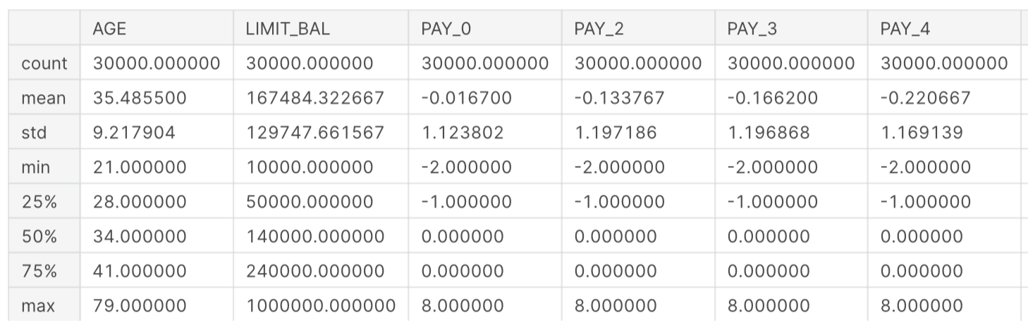
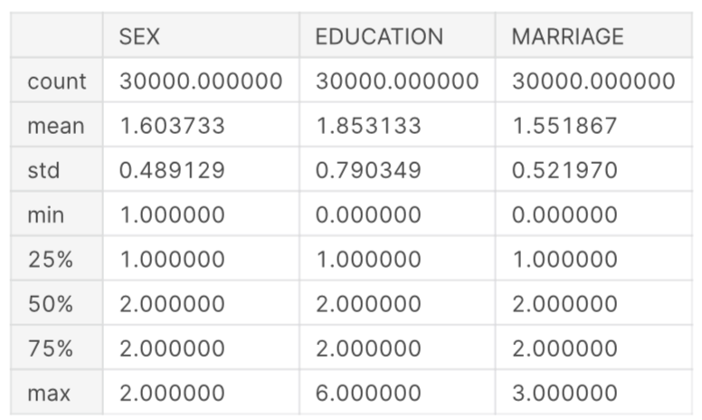
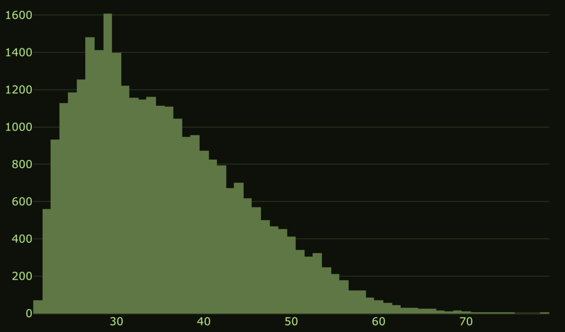
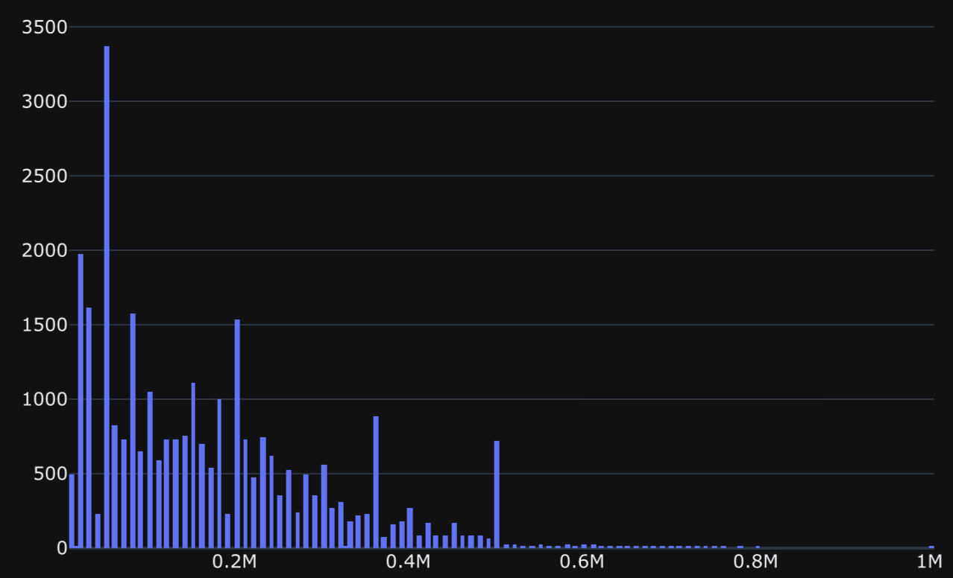
Attribute Details
Numerical Features
Categorical Features
More people who are aged between 20-30 and it goes on decreasing after 30. It is also a bit right skewed
More of the people have taken credit between 10k to 400k.
Notes:
Our initial EDA analysis showed that there was no data missing but there is data imbalance. 23,364 transactions did not default & 6636 transactions defaulted. We would use SMOTE technique later to solve this issue. More people in the dataset are aged between 20-30 and it goes on decreasing after 30. It is also a bit right skewed. More of the people have taken credit between 10k to 400k. Next slide

Slide 6
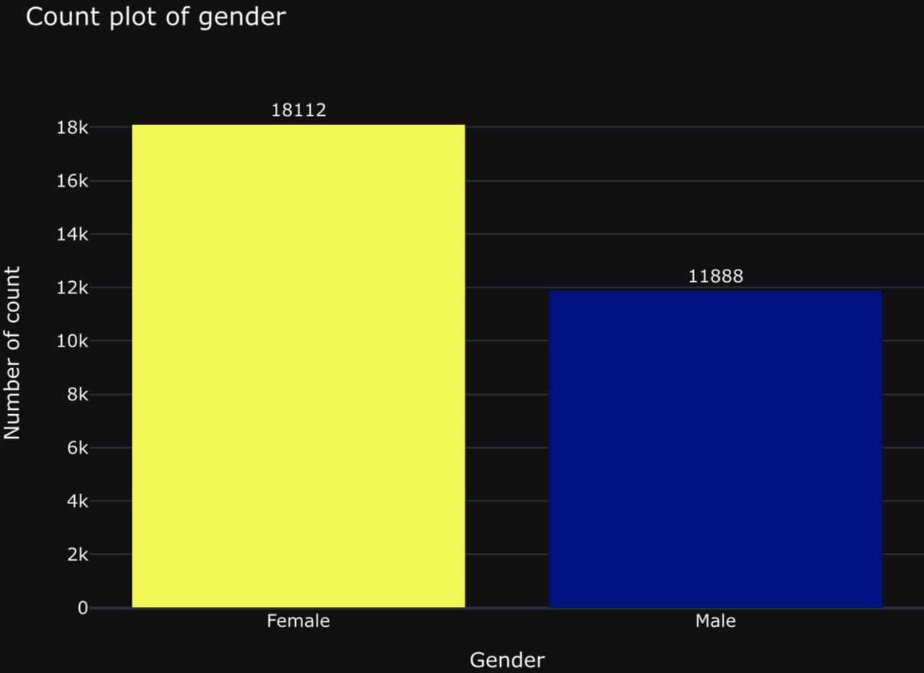
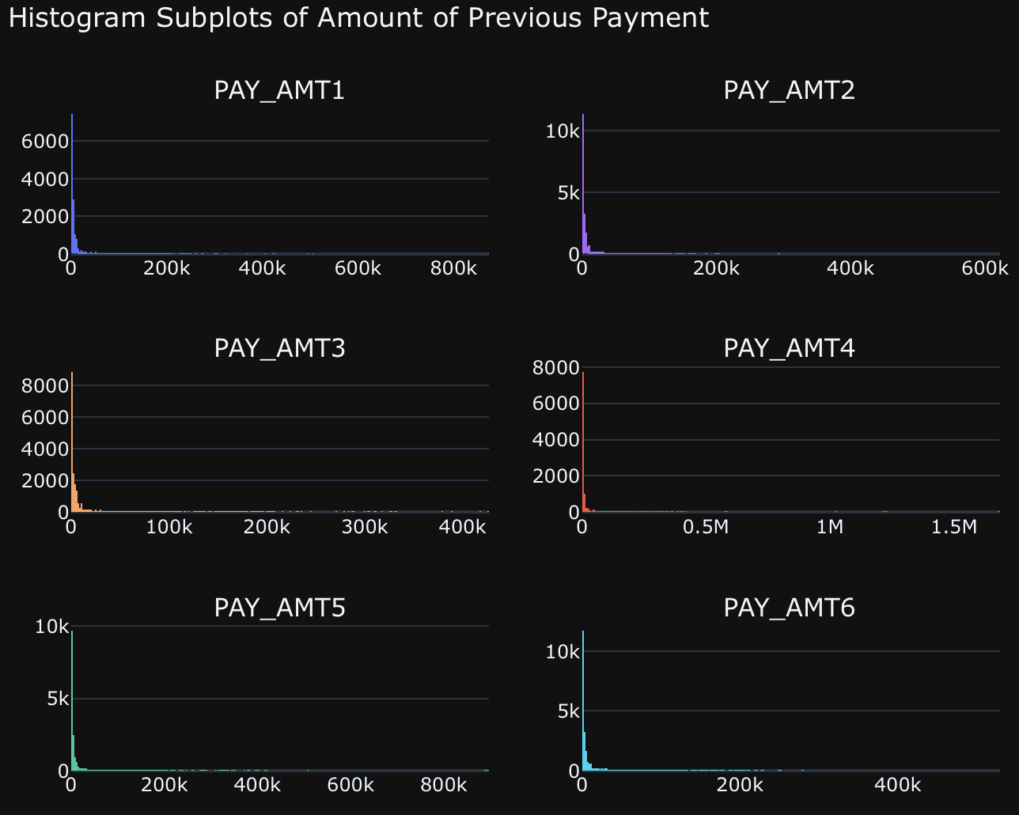
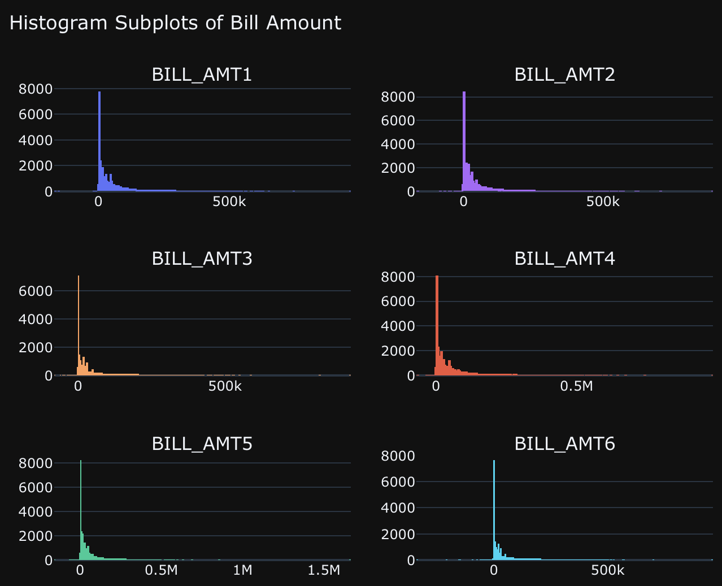
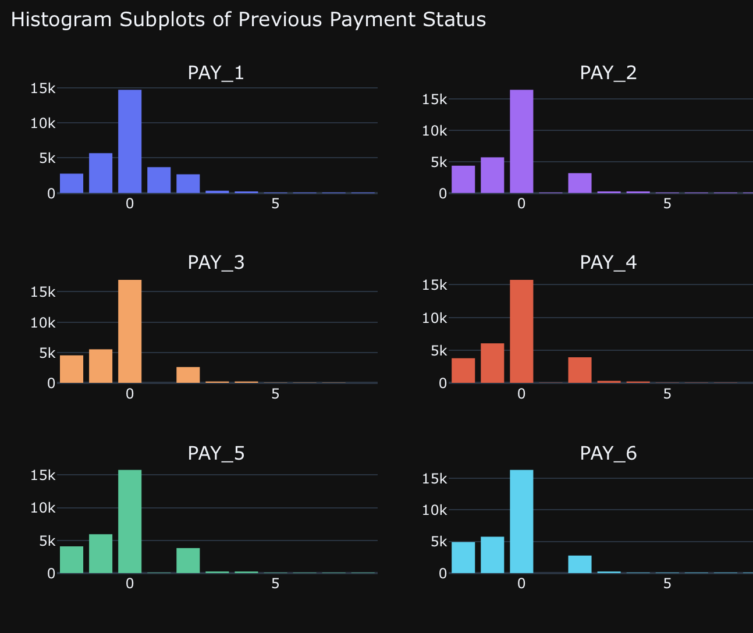
Strengths
Opportunities
EDA Analysis
Weaknesses
Threats
Jupiter is a gas giant
and the biggest planet
in the Solar System
There are more female customers
The previous bill amounts are highly right skewed
Mercury is the closest planet
to the Sun and the smallest
one in the Solar System
Saturn is a gas giant,
composed mostly of
hydrogen and helium
All the bill amounts are highly right skewed
Many customers who pay the previous amount duly but there are only some of them who pay late
Notes:
This slide shows more detailed analysis of the dataset. There are more female customers than male customers. The previous bill amounts are highly right skewed meaning the amount of credit balance is less than 100k for most clients. All the bill amounts are highly right skewed meaning the bill statement is also low for most clients mostly in the range of 10k to 250k . Last histogram shows that many customers pay their previous amount duly but there are few clients who pay late. Next slide

Slide 7
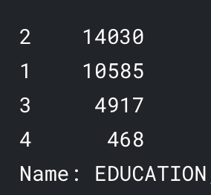
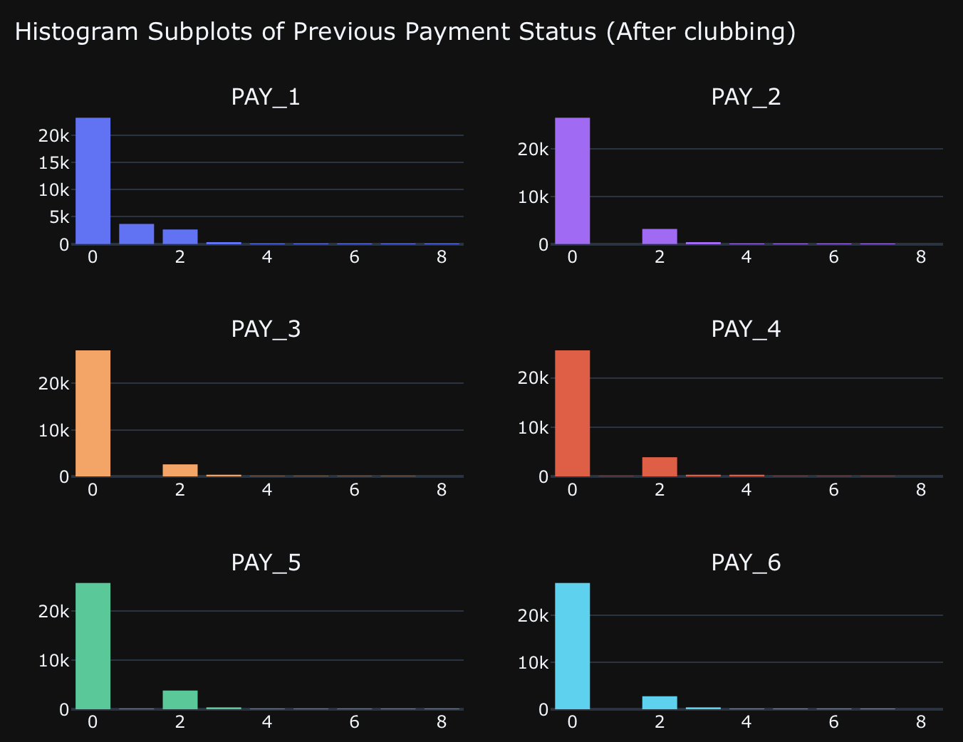
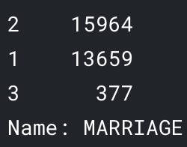
DATA Cleaning
Notes:
Based on our EDA analysis we identified that some data cleaning is required. Following are the updated details after data cleaning. In education column we combined values containing 0 for undocumented, 5 and 6 which are labeled as unknown to be put in a 'Other' cathegory i.e. 4. The 0 value in Marriage column was categorized to ‘Others’ i.e. 3. For previous payments -1 is paid duly, but there are "-2" and "0" labels in payment status variable. So we combined them and put everything as "0". And, we one hot encoded all the categorical features and converted them into datatype "object".
Next slide

Slide 8
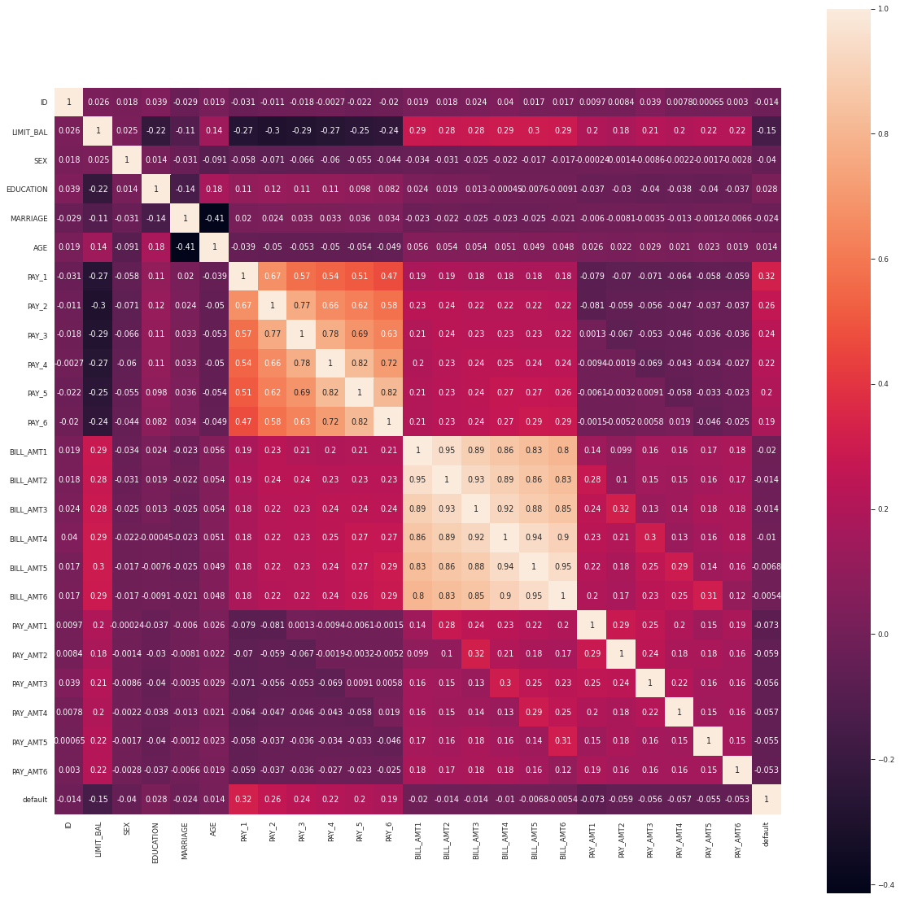
CORRELATION MATRIX
It's an interesting correlation plot. The heatmap shows that features are correlated with each other (collinearity), such as PAY_0,2,3,4,5,6 and BILL_AMT1,2,3,4,5,6. In those cases, the correlation is positive.
Notes:
Last step of our EDA analysis was to create a correlation matrix for all the features. The correlation matrix shows positive correlation between bill amounts & payment amounts in the dataset. Next Naina will explain the Data Modelling for our project.

Slide 9
RESAMPLING
Four sets of training data:
1) The normal train data with unbalance
2) Train data with oversampling
3) Train data with undersampling
4) Train data with SMOTE algorithm (32710 default and 16355 non-default)
Notes:
We built a baseline model that can be used to create predictions to measure the baseline performance. So we built a logistic regression without any hyperparameter tuning or feature engineering. So our baseline model had an accuracy of 0.77.
Since there was a lot of imbalance in the sample we planned to use resampling strategy- oversampling, undersampling and SMOTE for creating a new transformed version of the training dataset.
To create a synthetic sample and avoid overfitting, we used the SMOTE algorithm and now our dataset had 32710 default and 16355 non-default transactions.
So we have 4 sets of training data:
1) The normal train data with unbalance
2) Train data with oversampling
3) Train data with undersampling
4) Train data with SMOTE algorithm
!

Slide 10
Model BUILDING
Logistic Regression
Naive Bayes
K-Nearest Neighbours
Decision Tree
Random Forest
AdaBoost Classifier
GradientBoosting Classifier
XGBoost Classifier
Notes:
We then used 8 algorithms with the 4 different datasets and also with hyperparameter tuning the models:
Logistic Regression¶,Naive Bayes, K-Nearest Neighbours, Decision Tree, Random Forest, AdaBoost Classifier, GradientBoosting Classifier, XGBoost Classifier
We decided to include our observation for the top 5 models.
Our evaluation was based on K fold cross validation of AUC (Area Under The Curve) ROC (Receiver Operating Characteristics) curve score which is considered as the best metric for binary classification and also the test score.

Slide 11
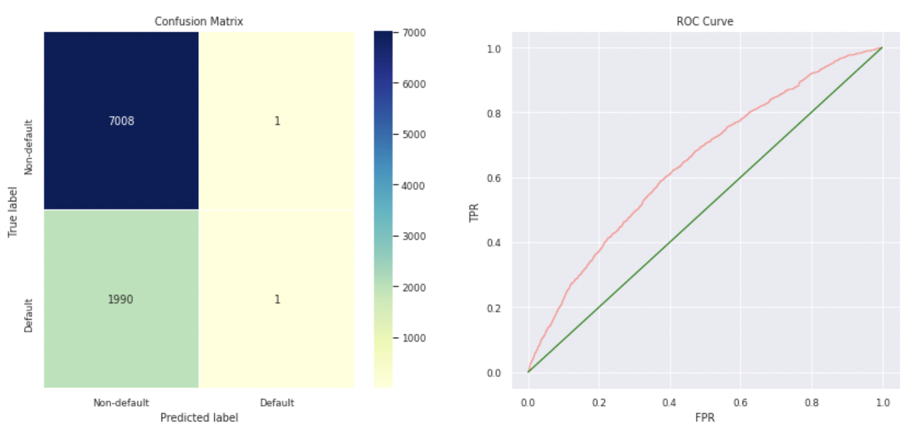
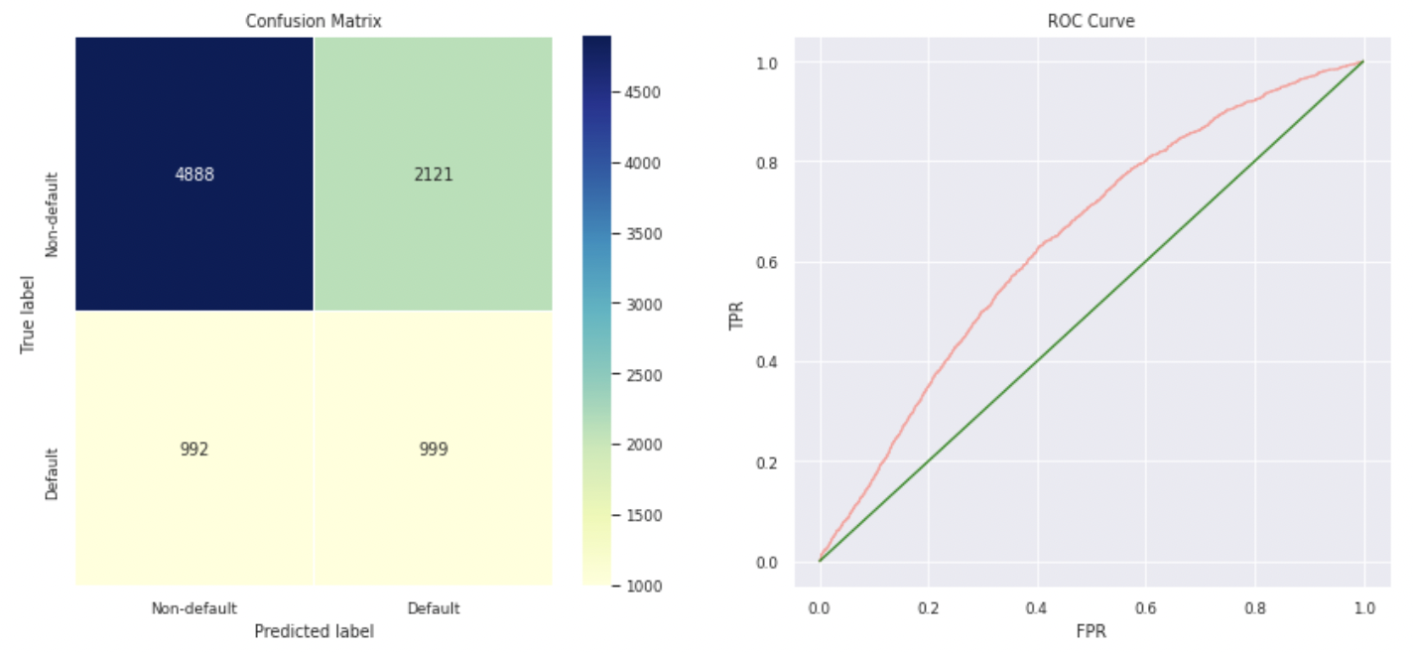
Logistic regression
Normal Sampling
SMOTE
Overall Train Accuracy 0.7781904761904762
Train AUC Score 0.6566949665965613
Overall Test Accuracy 0.7787777777777778
Test AUC Score 0.6437886525890978
Overall Train Accuracy 0.6180984408437786
Train AUC Score 0.6571368784593513
Overall Test Accuracy 0.6541111111111111
Test AUC Score 0.6421998221559007
The best AUC score for Logistic Regression is seen in Normal sampling data with a Test AUC score of 0.64 and K-fold score of 0.615
Notes:
We found the best parameters for all the datasets for each model.
So, for every model, we had setup the hyperparameter grid, Instantiated the respective classifier, normalized and standardized the data, instantiated the RandomizedSearchCV and gridsearch CV and finally printed the tuned parameters and score.
The best AUC score for Logistic Regression is seen in Normal sampling data with a Test AUC score of 0.64 and K-fold score of 0.615

Slide 12
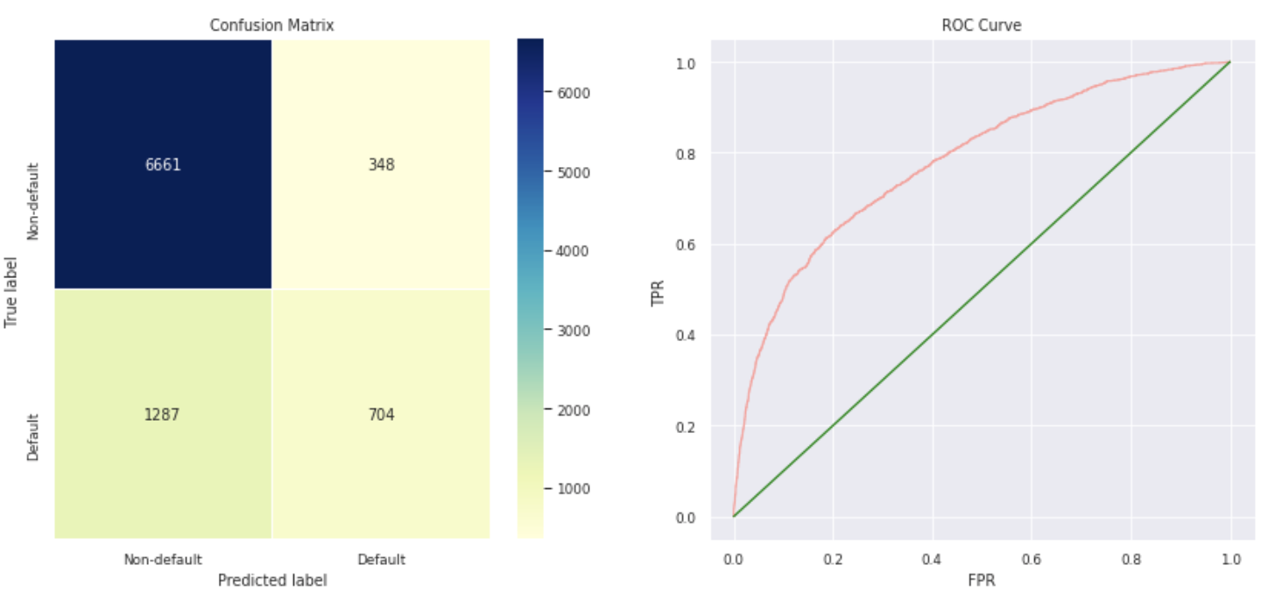
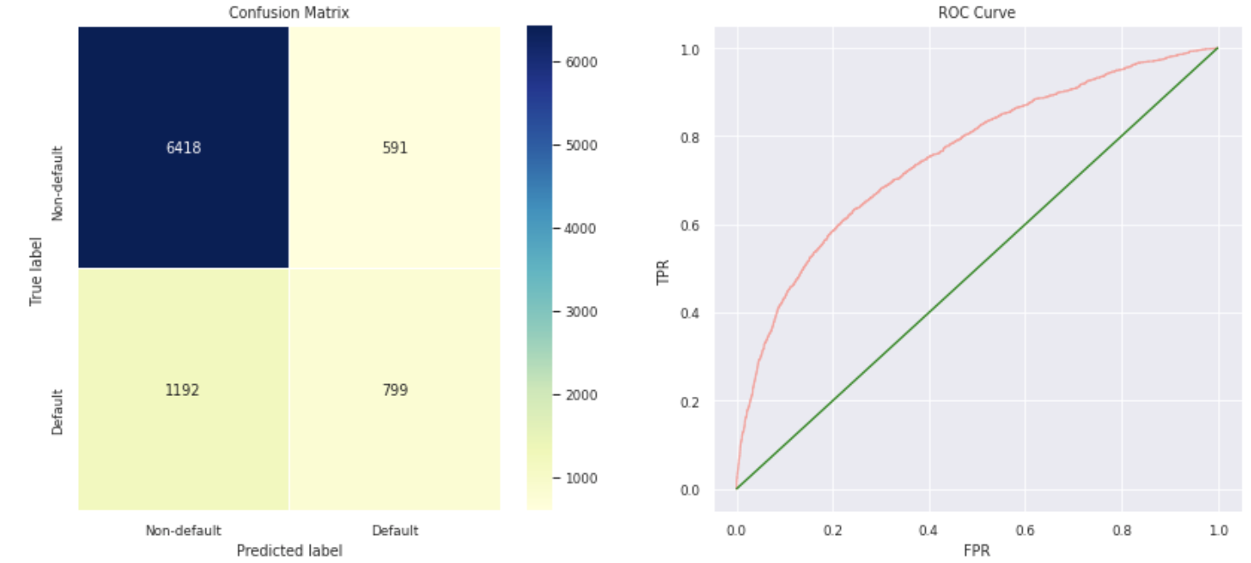
XG Boost
Normal Sampling
SMOTE
Overall Train Accuracy 0.8318095238095238
Train AUC Score 0.8167430915054468
Overall Test Accuracy 0.8183333333333334
Test AUC Score 0.7808003041794797
Overall Train Accuracy 0.9972179761540814
Train AUC Score 0.9999721088232552
Overall Test Accuracy 0.8018888888888889
Test AUC Score 0.7553226930231555
The best score for XG Boost Classifier is registered when trained with the normal sampling data with an Test AUC score of 0.78 and train K-Fold score of 0.716 after it was standardized
Notes:
The best score for XG Boost Classifier is registered when trained with the normal sampling data with an Test AUC score of 0.78 and train K-Fold score of 0.716 after it was standardized

Slide 13
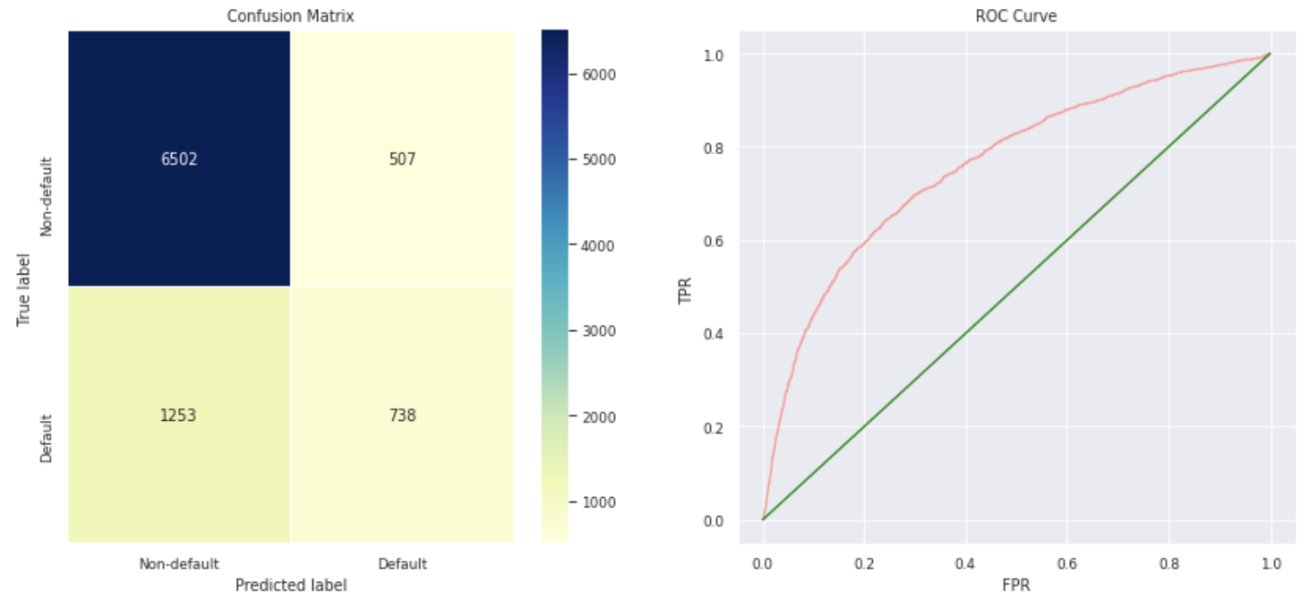
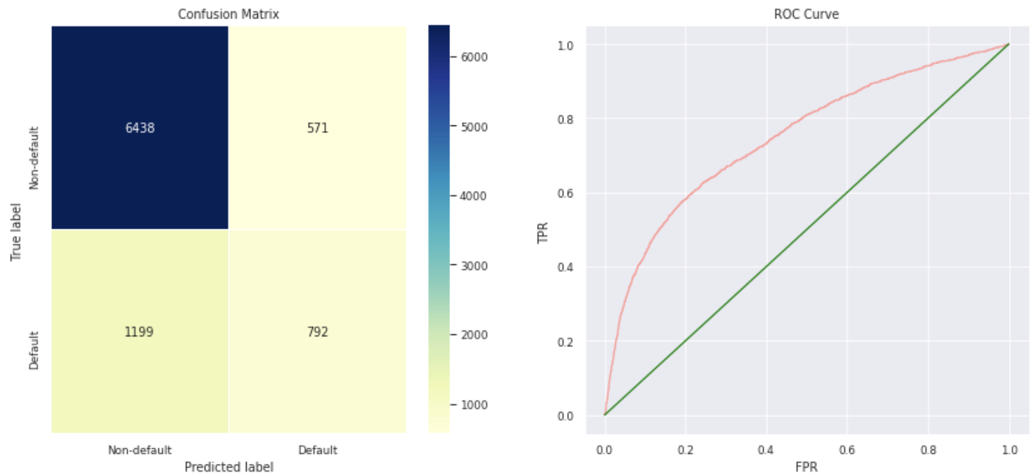
GRADIENT Boost
Normal Sampling
SMOTE
Overall Train Accuracy 0.8684761904761905
Train AUC Score 0.8970215538645874
Overall Test Accuracy 0.8044444444444444
Test AUC Score 0.759694628109271
Overall Train Accuracy 0.8953225313359828
Train AUC Score 0.9604183994285309
Overall Test Accuracy 0.8033333333333333
Test AUC Score 0.7472757097336071
The best score for Gradient Boost Classifier is registered when trained with the SMOTE data with an Test AUC score of 0.747 and train K-Fold score of 0.85 after it was standardized
Notes:
The best score for Gradient Boost Classifier is registered when trained with the SMOTE data with an Test AUC score of 0.747 and train K-Fold score of 0.85 after it was standardized

Slide 14
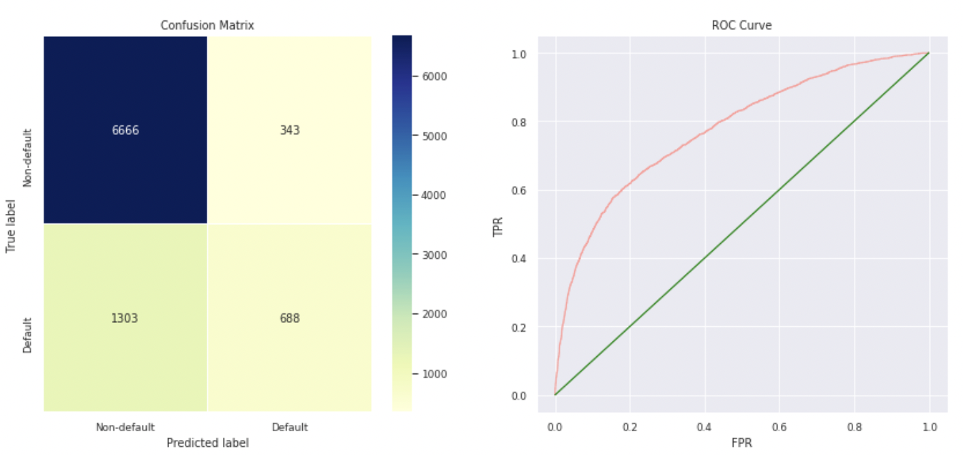
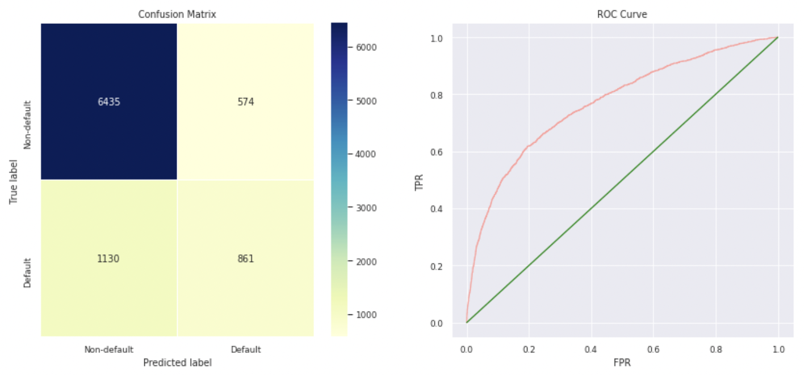
Random forest
Normal Sampling
SMOTE
Overall Train Accuracy 0.842
Train AUC Score 0.8452947667123322
Overall Test Accuracy 0.8171111111111111
Test AUC Score 0.7765993124001651
Overall Train Accuracy 0.8618771018037298
Train AUC Score 0.9376192214153992
Overall Test Accuracy 0.8106666666666666
Test AUC Score 0.7701243912630378
The best score for Random forest is registered when trained with the SMOTE data with an Test AUC score of 0.77 and train K-Fold score of 0.85
Notes:
The best score for Random forest is registered when trained with the SMOTE data with an Test AUC score of 0.77 and train K-Fold score of 0.85

Slide 15
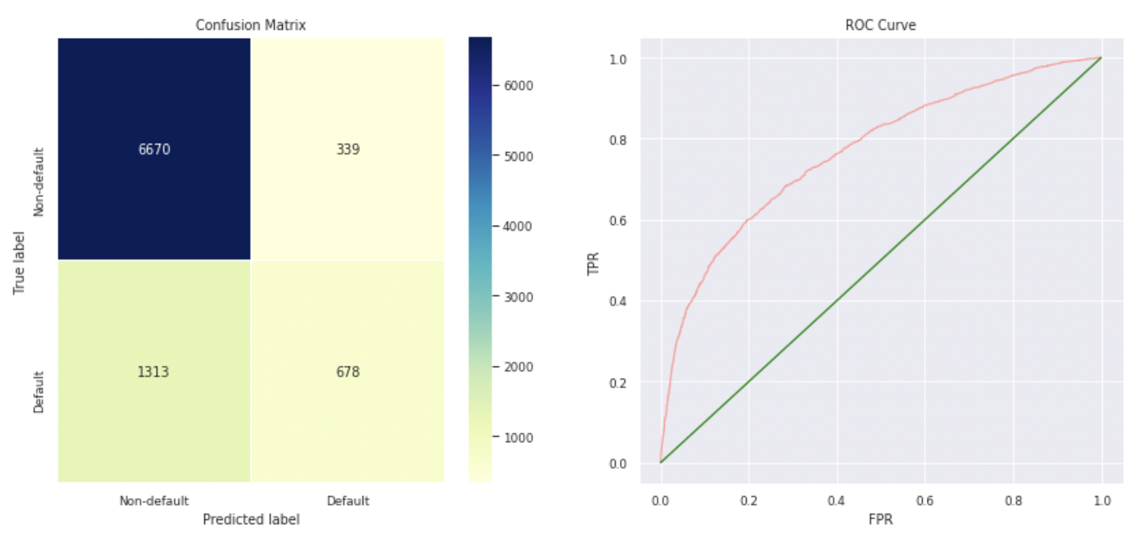
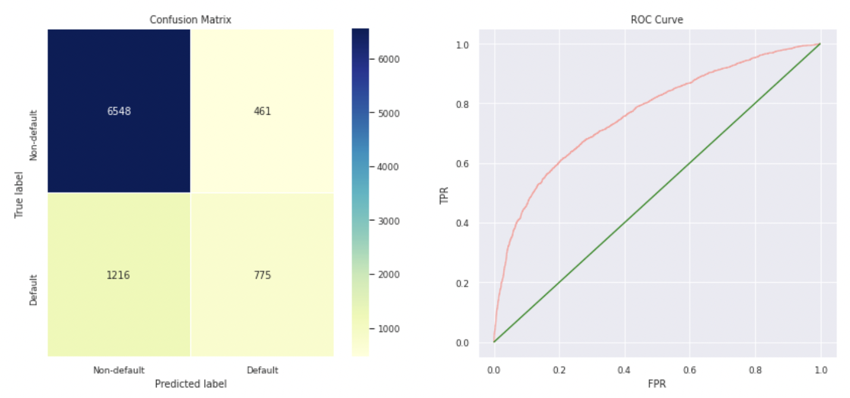
Ada boost
Normal Sampling
SMOTE
Overall Train Accuracy 0.8211428571428572
Train AUC Score 0.7800456962858852
Overall Test Accuracy 0.8164444444444444
Test AUC Score 0.7677436178597669
Classification Report of Test
Overall Train Accuracy 0.8620911036380312
Train AUC Score 0.9247609739611631
Overall Test Accuracy 0.8136666666666666
Test AUC Score 0.7644839429021408
The best score for Adaboost Classifier is registered when trained with the SMOTE data with an Test AUC score of 0.764 and train K-Fold score of 0.86
Notes:
The best score for Adaboost Classifier is registered when trained with the SMOTE data with an Test AUC score of 0.764 and train K-Fold score of 0.86

Slide 16
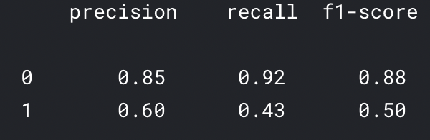
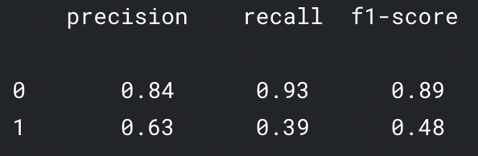
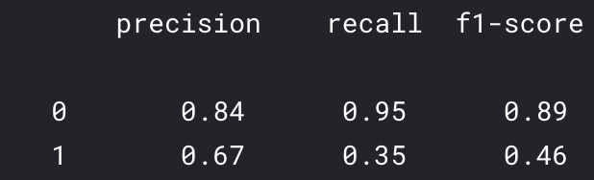
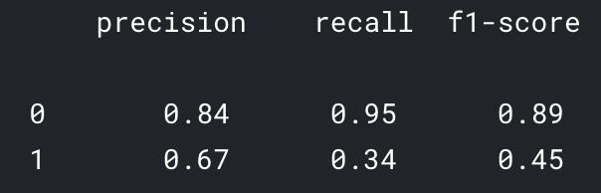
rANDOM FOREST
Ada boost
smote
smote
Normal sampling
Normal sampling
Weaknesses
Notes:
Model selection solely based on accuracy doesnot make much sense because the data-set is unbalanced and skewed. Thus, we also considered recall, precision and f- measure alongwith cross-validation metrics. High recall means more defaulters being caught and reasonably high precision means more less false positives. Thus, a good model is a balance between High recall and reasonably high precision.

Slide 17
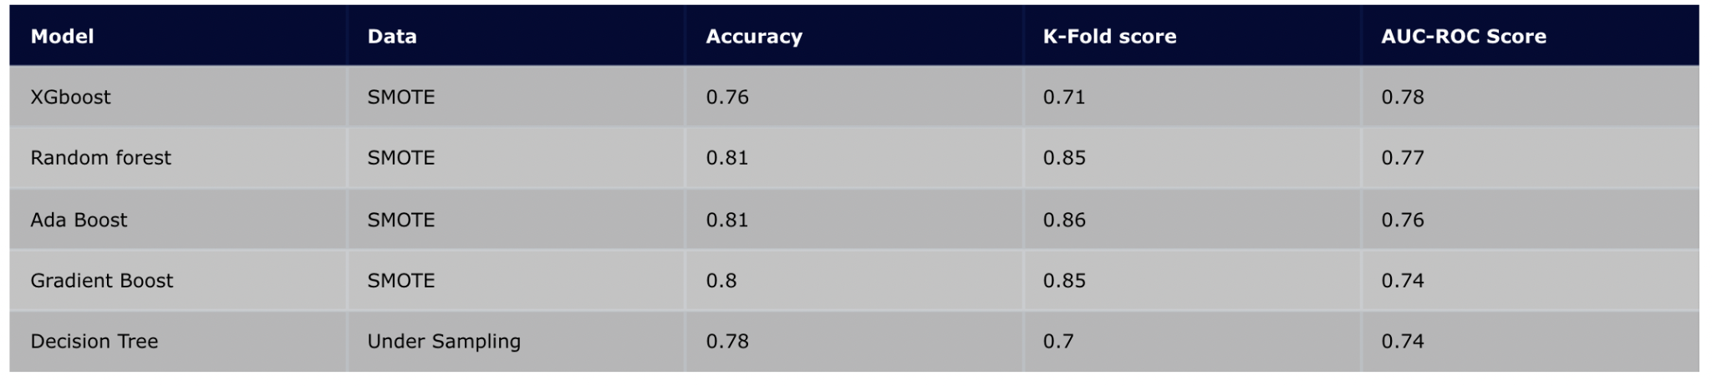
predictive models with most roi
Above are the top 5 most scoring models. The models are performing well for SMOTE data and also undersampled data rather than imbalanced data. Thus before modeling, resampling techniques should be used to make sure that the models are not biased.
Notes:
Above are the top 5 most scoring models. The models are performing well for SMOTE data and also undersampled data rather than imbalanced data. Thus before modeling, resampling techniques should be used to make sure that the models are not biased.

Slide 18
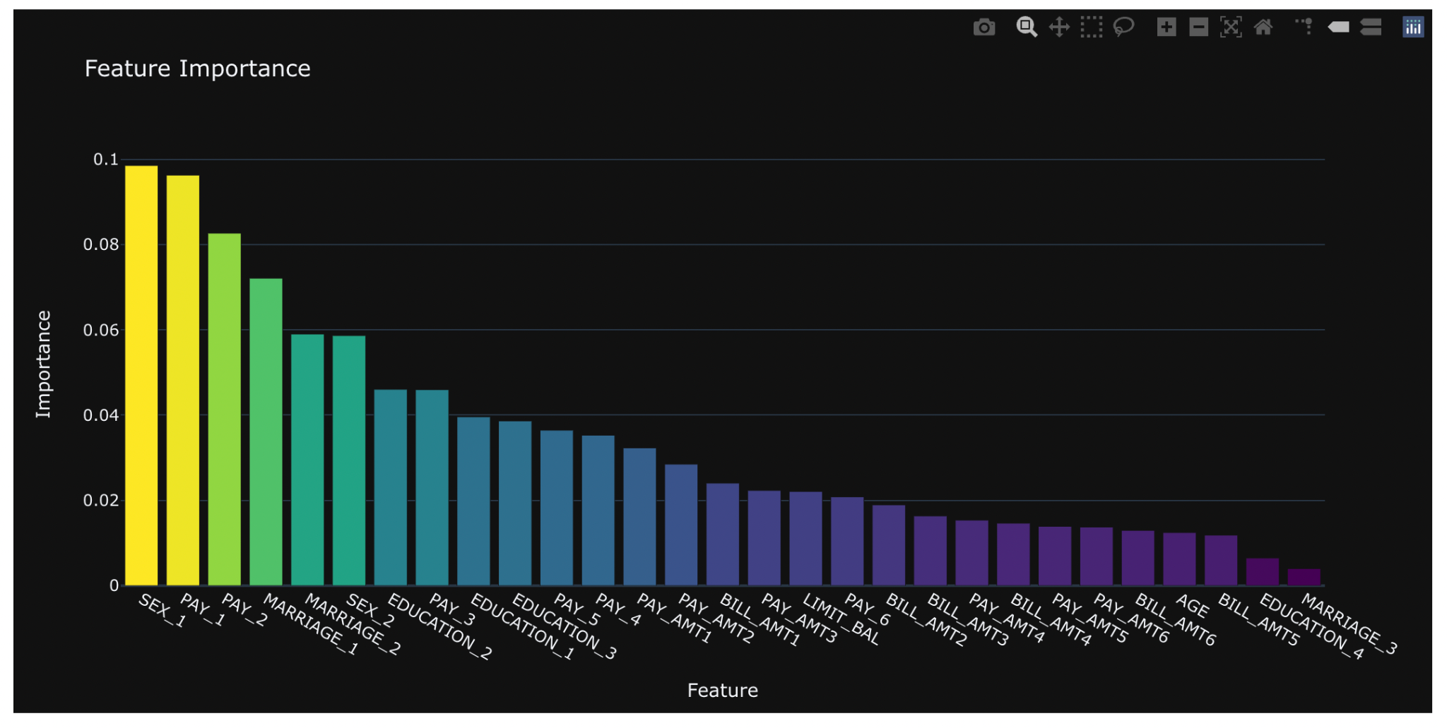
It looks like the sex, repayment status and repayment amount are more important features!
Notes:
We finally created this feature importance graph of our best model Random Forest by defining a function
It looks like the sex,repayment status and repayment amount are more important features!

Slide 19
Strengths
Opportunities
SWOT
Weaknesses
Threats
High level of accuracy to predict default credit card transactions
Most features related to credit card transactions are analyzed
1. This model can be utilized in many banking services such as home loan, car loan etc
2. Due to Covid-19 risk of default is much higher, this model will be very useful for banks
Imbalanced Data set
Only 30,000 transactions
Lot of dependency on external agencies to collect data
This model uses historical data collected in Taiwan which is an Emerging Market. Countries like USA, Europe have very different market

Slide 20
Summary
For this project, we analysed 30,000 credit card transactions for predicting default transactions
Performed data cleaning
Performed EDA analysis and found data imbalance & high skewness
Split the data into 70% training & 30% test
Data Modeling (including SMOTE)
Model Performance (including SMOTE)
Developed Feature Importance
Deployment
Reference: Default of Credit Card
Notes:
for this project, we analysed 30,000 credit card transactions for predicting default transactions
Performed data cleaning
We first investigated the datasets by using exploratory data analysis techniques, including data normalization.
found data imbalance & high skewness
Feature engineering and one hot encoding
Split the data into 70% training & 30% test
Resampling techniques
Data Modeling (including SMOTE)
Model Performance (including SMOTE): model evaluated based on performance evaluation metrics
Developed Feature Importance
Deployment

Slide 21
CONCLUSION
Random Forest & AdaBoost give the highest level of accuracy of 81%
Biases may enter the modeling process when you look at the data:
Outliers
Overfitting and underfitting
Selection Bias
Confirmation Bias
Next Steps to improve accuracy:
Collect different data set:
Length of credit history
Different types of credit
Gather more recent data
Gather dataset from different geographical location such as USA, Europe, China, India
Reference: Default of Credit Card ((UCI Machine Learning Repository: default of credit card clients Data Set. (2021). Retrieved 25 October 2021, from https://archive.ics.uci.edu/ml/datasets/default+of+credit+card+clients)
Notes:
Random Forest & AdaBoost give the highest level of accuracy of 81%
Biases may enter the modeling process when you look at the data:
Outliers
Overfitting and underfitting
Selection Bias
Confirmation Bias
Therefore, when the financial institution considers issuing the client a credit card, the institution needs to check the payment history of that person because the decision on whether pay on duly or owe the bill on a specific month usually relates to the previous payment history.
Although the financial institution often collects clients’ personal information such as age, educational level, and marital status when people apply for credit cards, this information also affects the default behavior. In other words, the financial institution should equally consider their potential clients who are men or women, obtain bachelor degrees or master degrees, single or married when decide whether approve their credit card/loan applications.
We tried our best to make a thorough analysis, and there are still a few possible improvements that may require longer-term action.
Next Steps to improve accuracy:
Collect different data set:
Length of credit history
Different types of credit
Gather more recent data
Gather dataset from different geographical location such as USA, Europe, China, India
The financial market changes rapidly every day, and people’s economic status and performance are affected by the market all the time. So, if more economic indicators will be added to the dataset, this will leads to a more generic model.

Slide 22
Thanks
Team- 15

Slide 23
Appendix
Reference:
Default of Credit Card ((UCI Machine Learning Repository: default of credit card clients Data Set. (2021). Retrieved 25 October 2021, from https://archive.ics.uci.edu/ml/datasets/default+of+credit+card+clients)
IEEE Xplore Full-Text PDF: IEEE Xplore Full-Text PDF: . (2021). Retrieved 25 October 2021, from https://ieeexplore.ieee.org/stamp/stamp.jsp?arnumber=9239944
Notes:
An Investigation of Credit Card Default Prediction in the Imbalanced Datasets IEEE Access
This work was supported by the Norwegian University of Science and Technology, Norway.

Slide 24
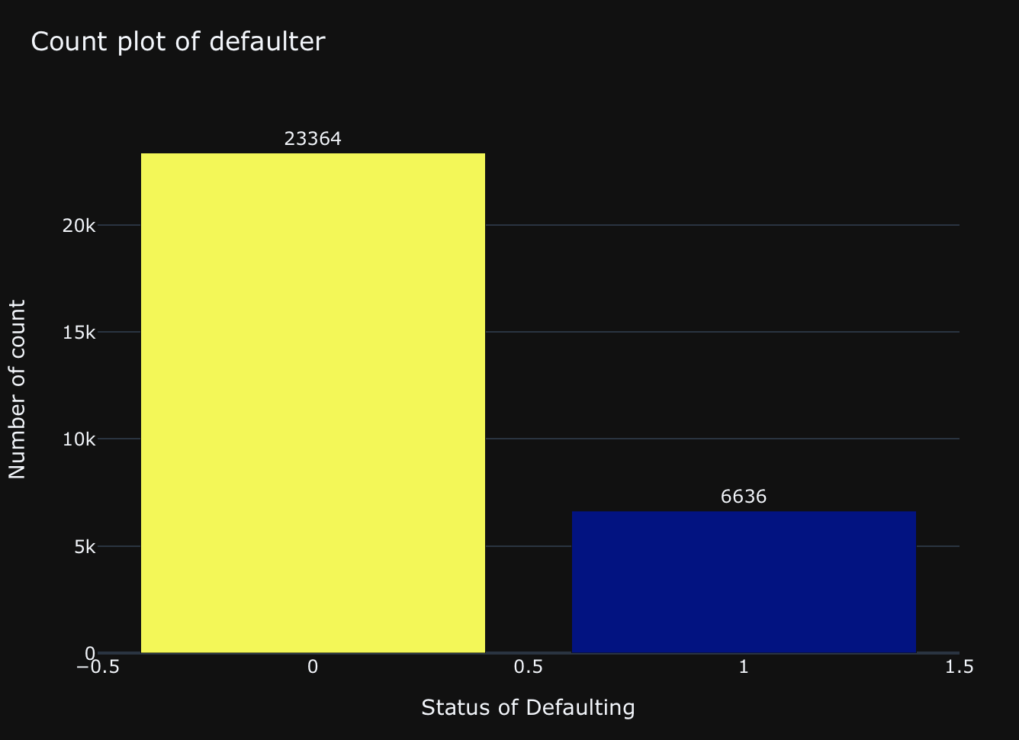
Count of default & Non Default Transactions

Slide 25
Biases May Enter Your Modeling Process
Model evaluation will be based on K fold cross validation of AUC. ROC curve score which is considered as the best metric for binary classification and also the test score.
Higher the AUC, better the model is at predicting 0s as 0s and 1s as 1s.
Biases may enter your modeling process when you look at your data:
Outliers
Overfitting and underfitting
Selection Bias
Confirmation Bias

Slide 26
Observations
On
H2o.Ai
Notes:
We also used H20.ai platform for modeling.

Slide 27
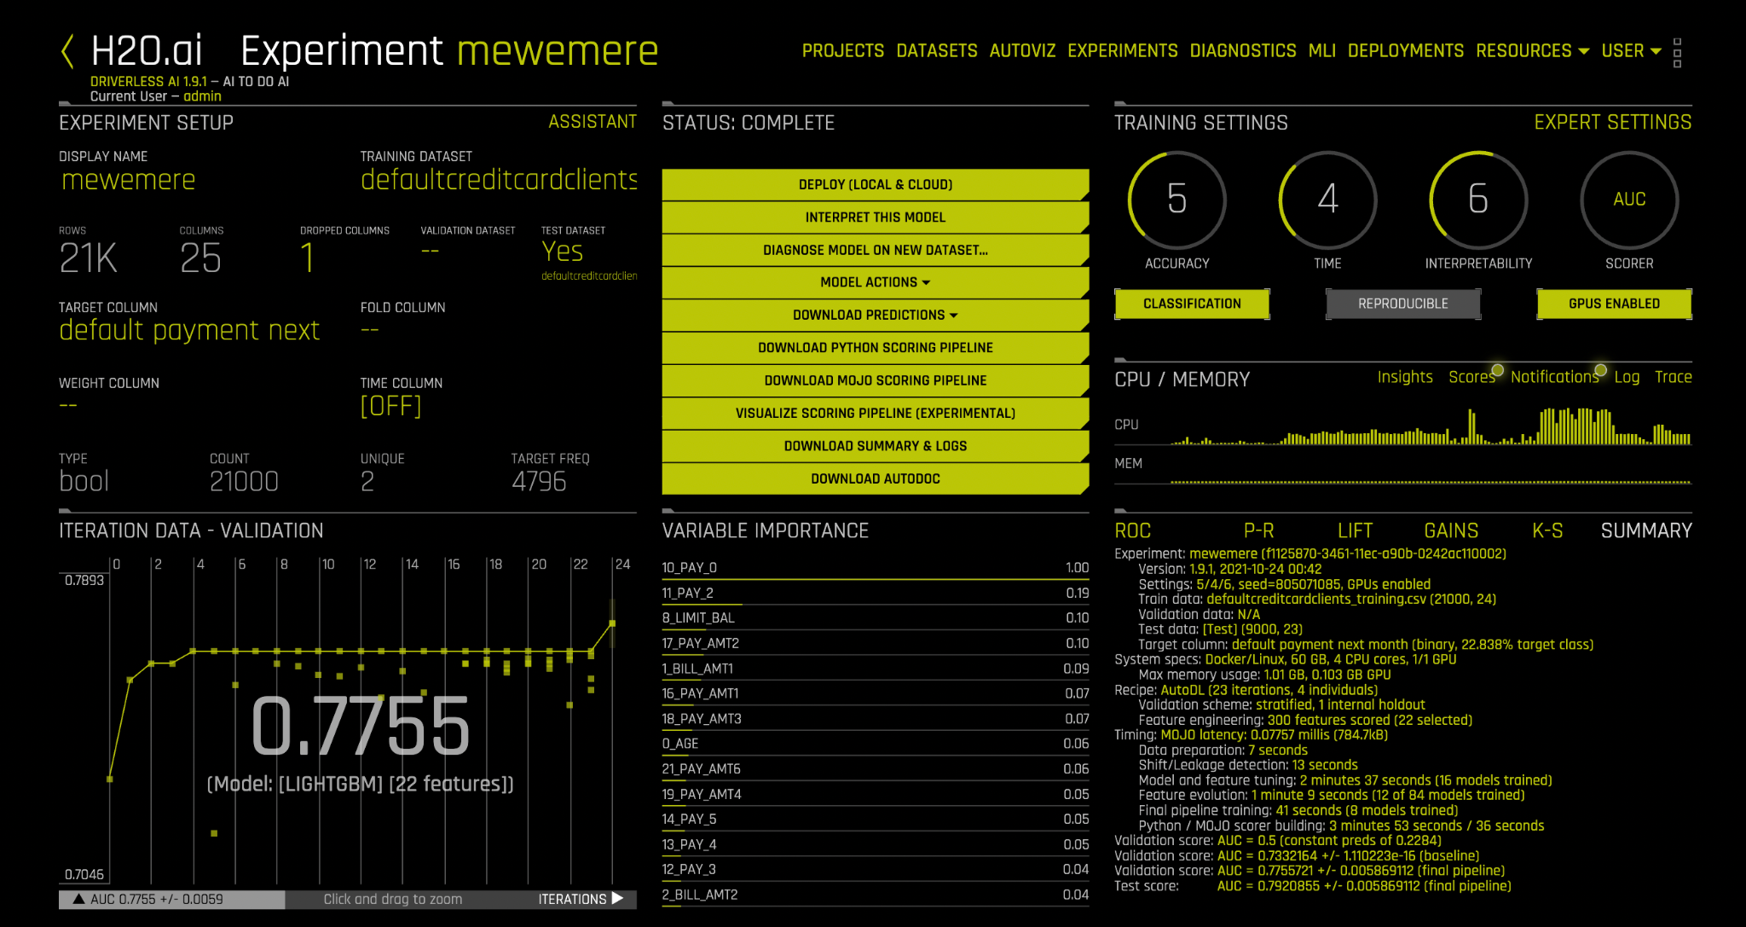

Slide 28
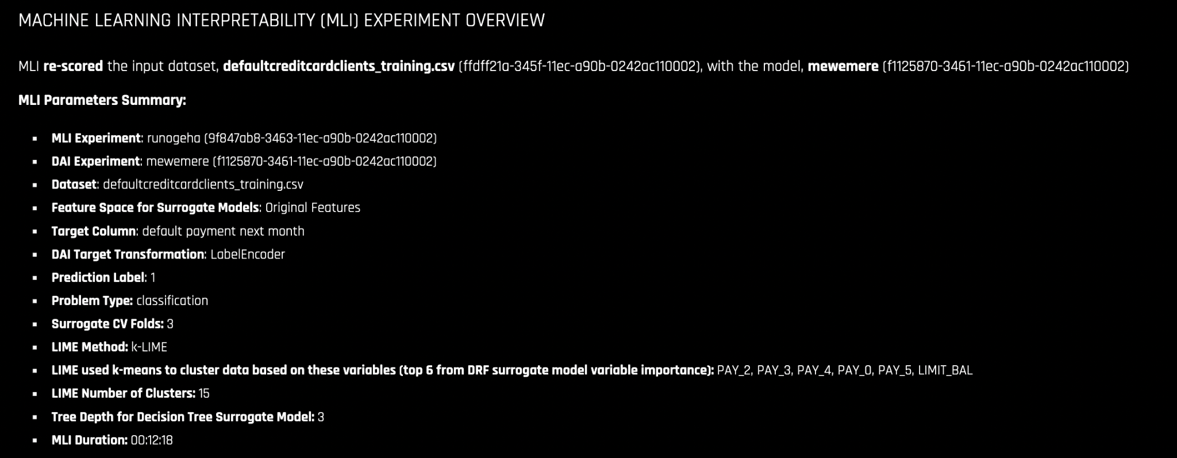

Slide 29
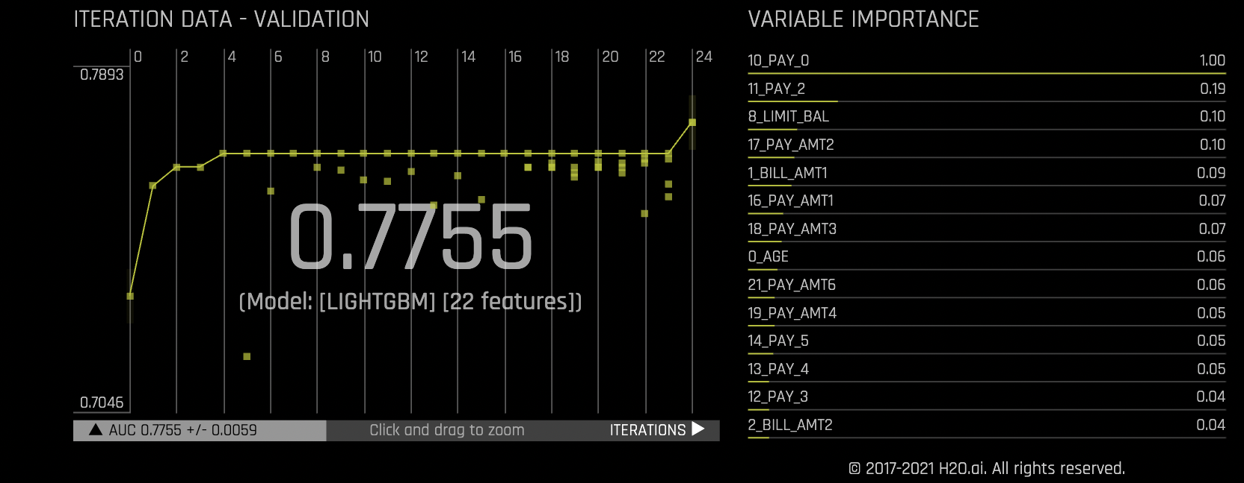

Slide 30
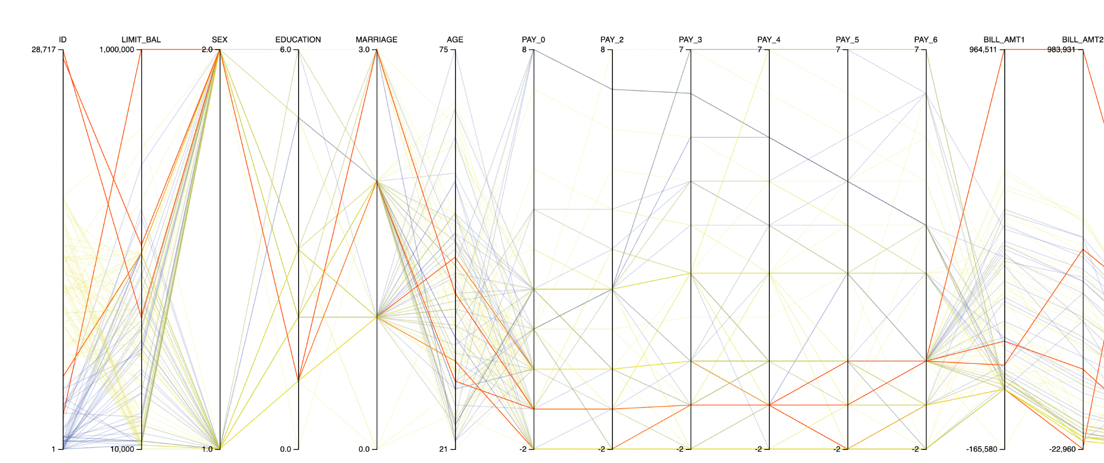
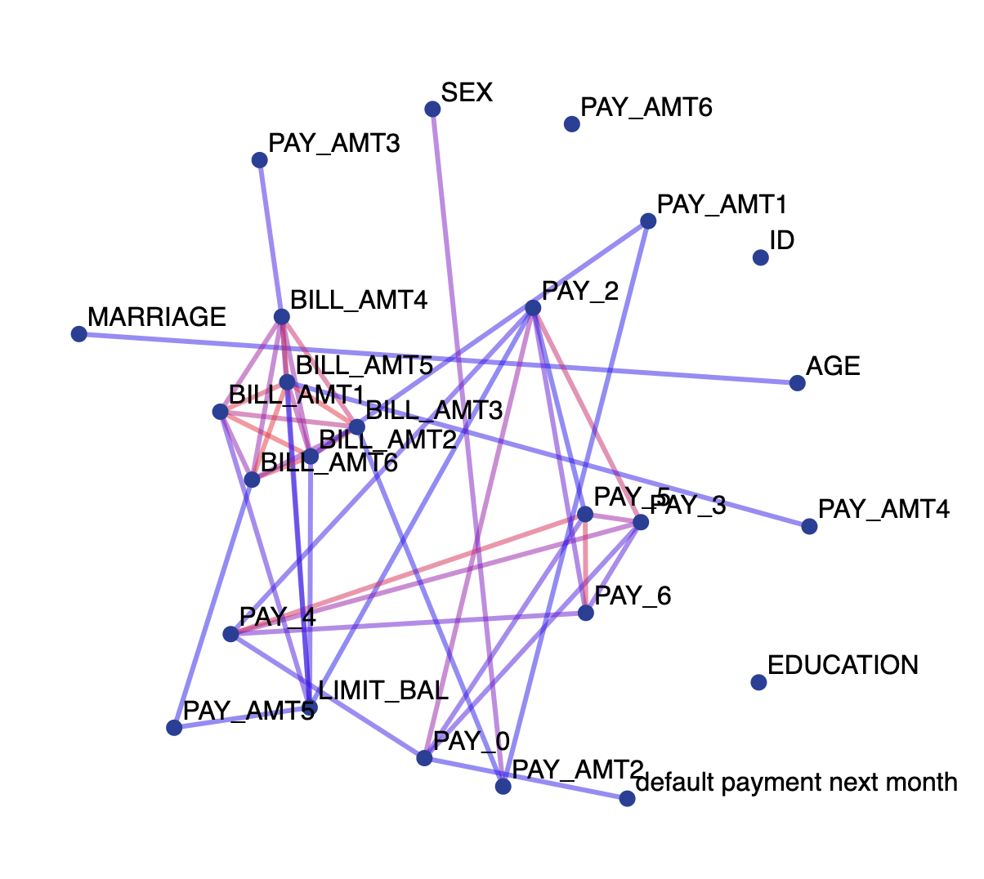
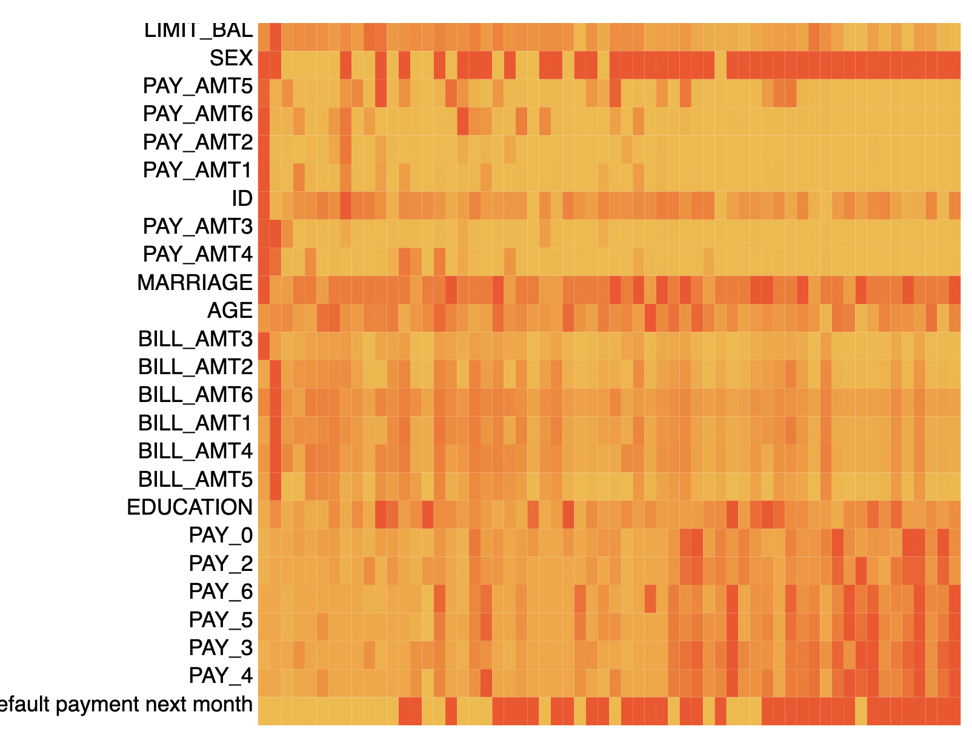
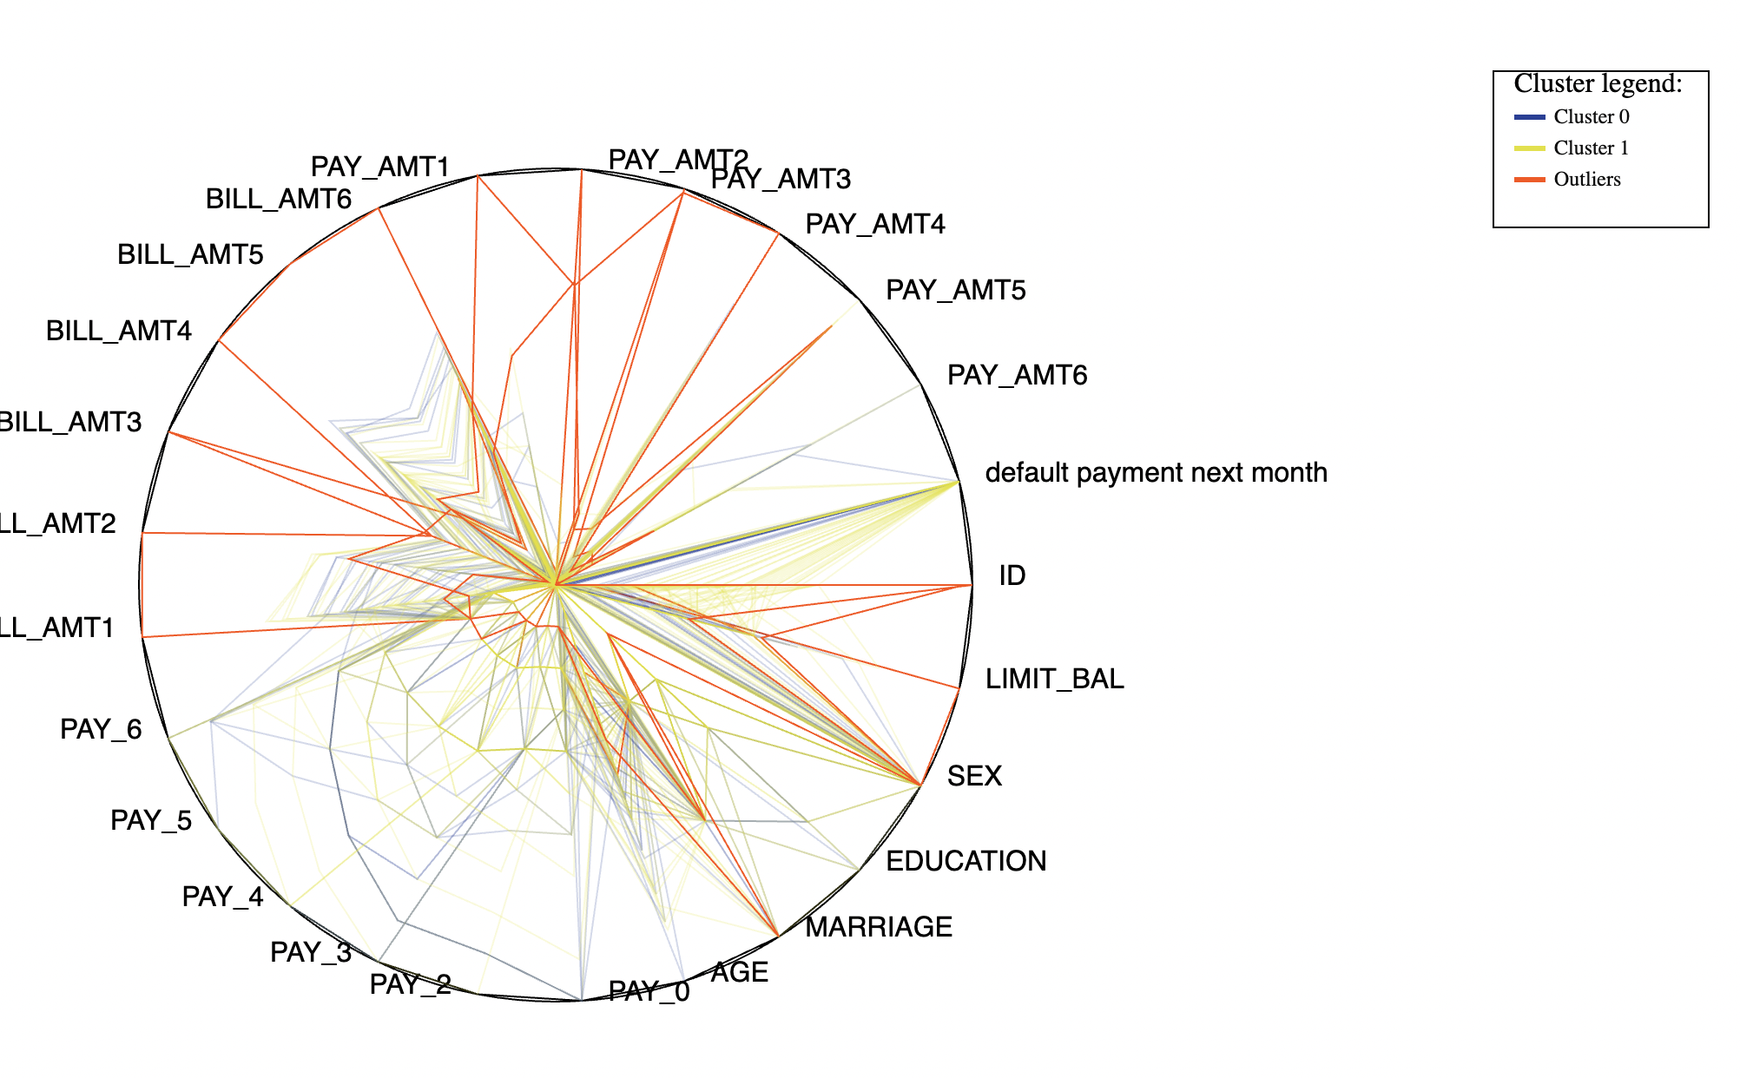
Strengths
Opportunities
AUTOVIZ
Weaknesses
Threats
Jupiter is a gas giant
and the biggest planet
in the Solar System
Mercury is the closest planet
to the Sun and the smallest
one in the Solar System
Saturn is a gas giant,
composed mostly of
hydrogen and helium
D

Slide 31
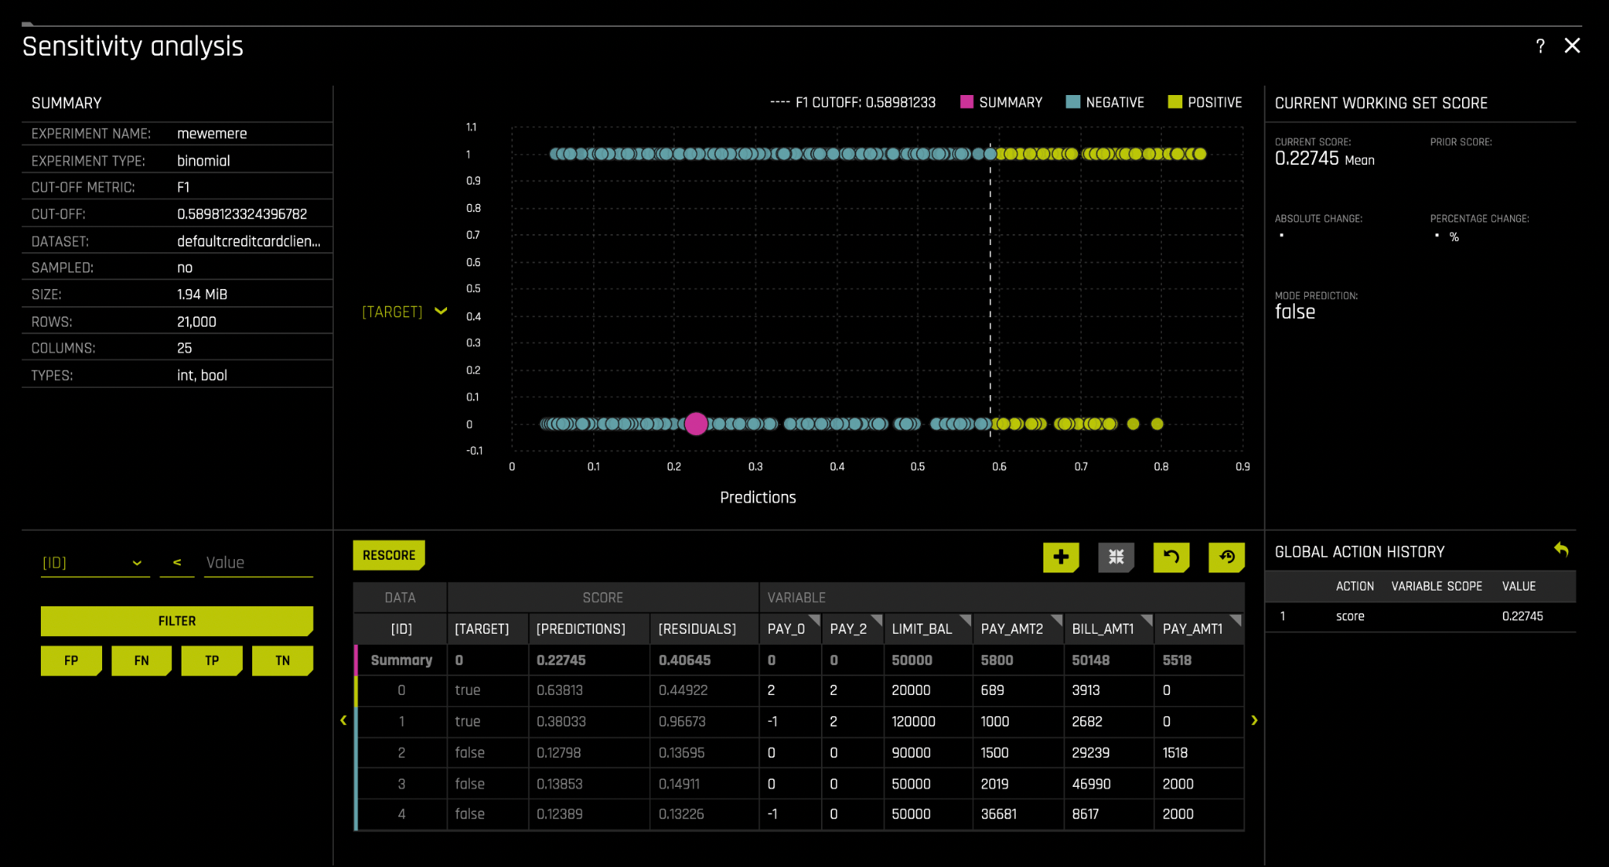

Slide 32
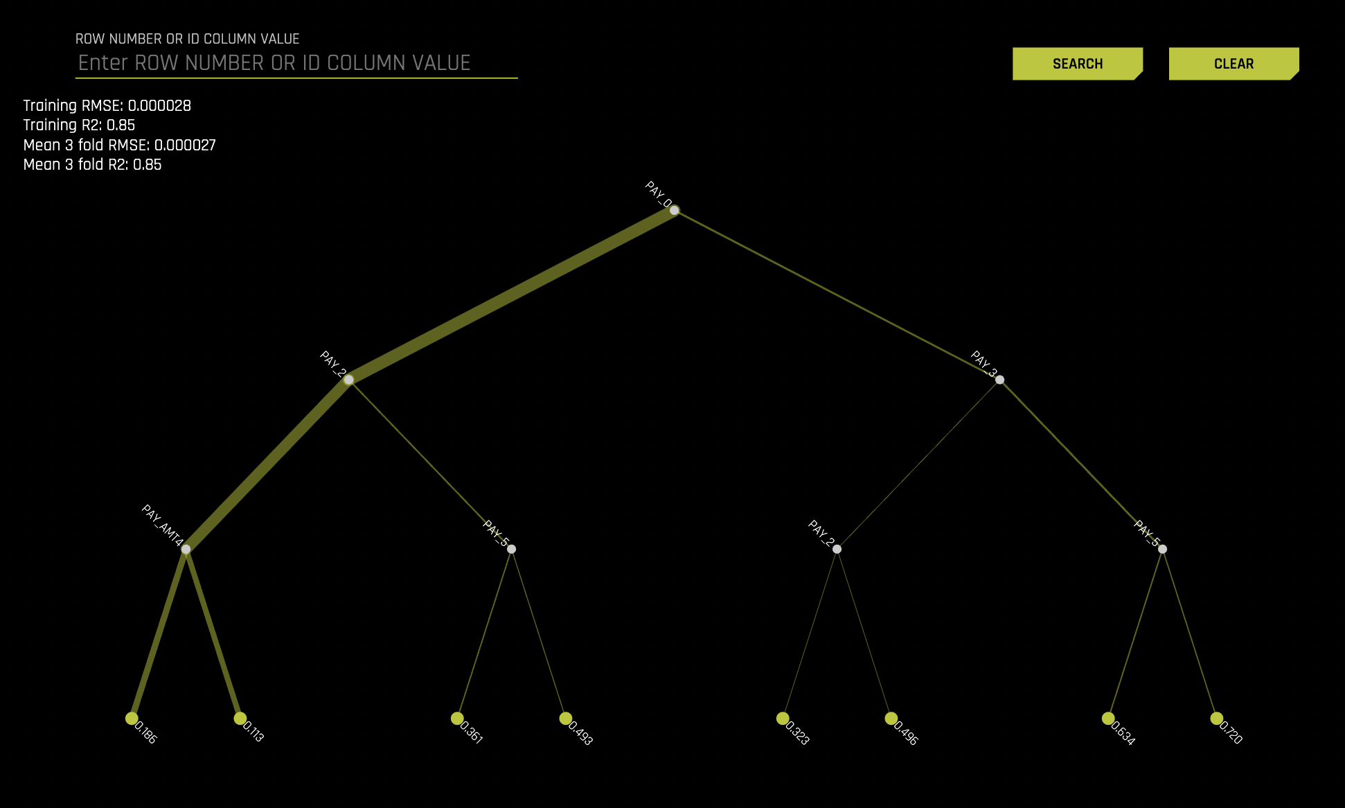

Slide 33
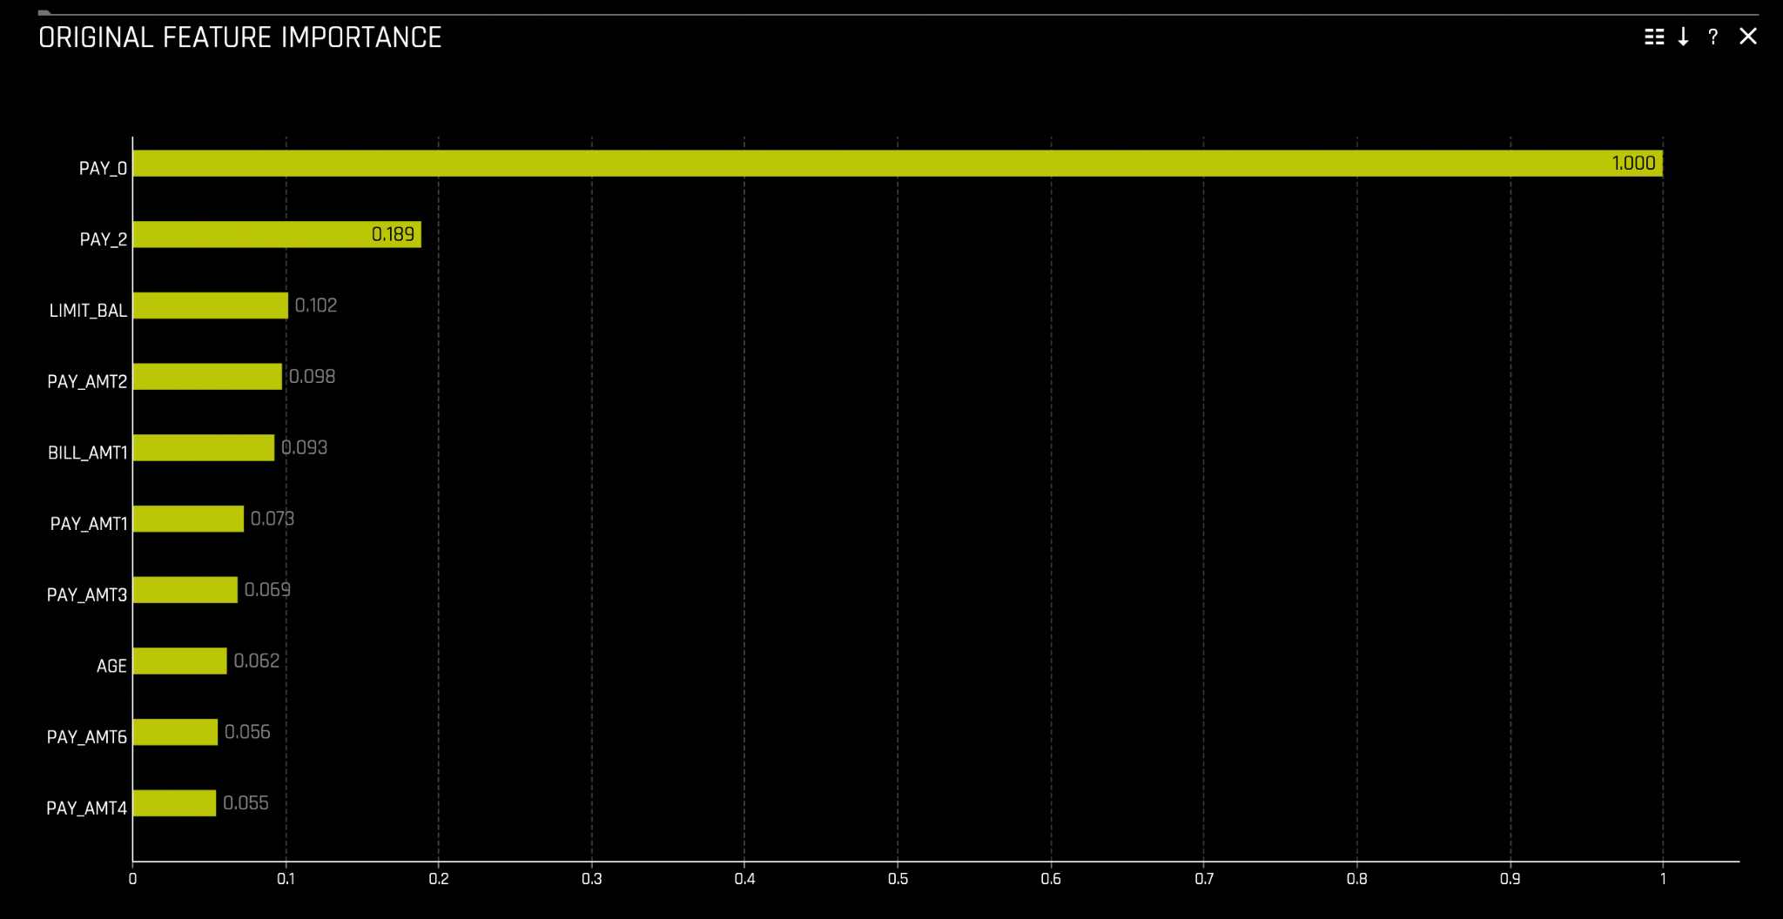

Slide 34
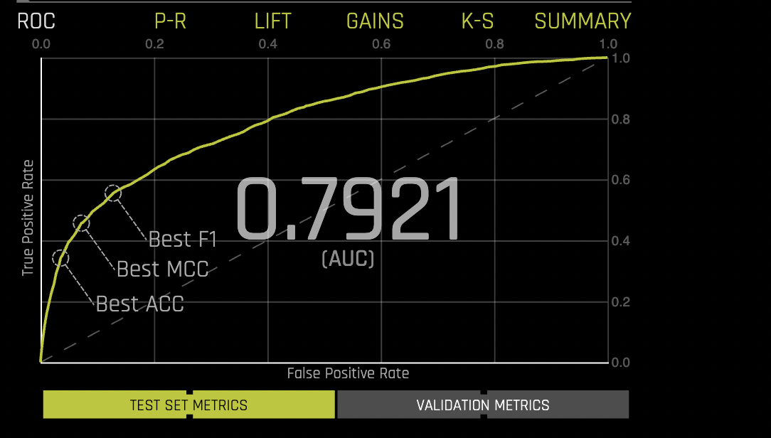
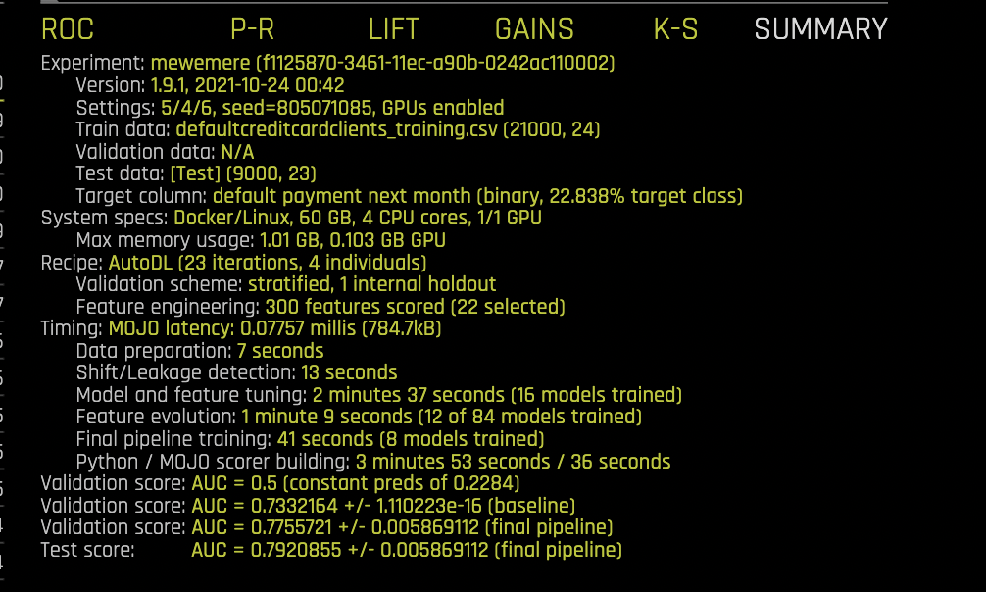
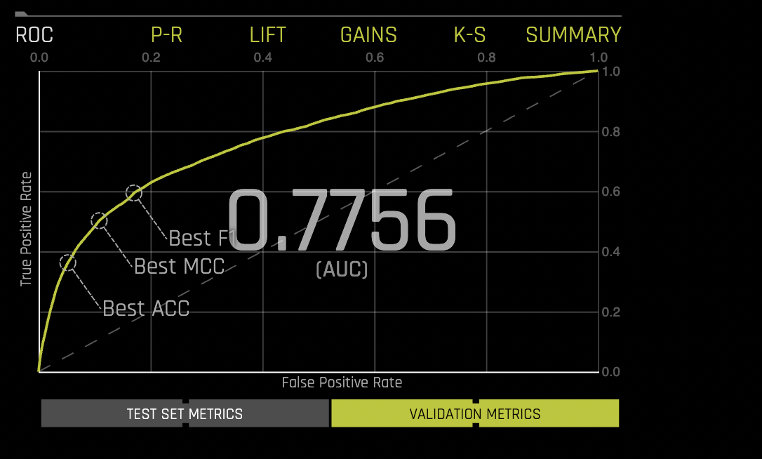

Slide 35
